Slide 1



Stock Trend Predication
Team Members:
Patel Preet
Tandel Manasvi
Patel Sujal
Dalal Kush
Guided by:
Abdul Aziz Md, Master Trainer, Edunet Foundation

Slide 2
Stock Trend Predication
OUTLINE
Abstract
Problem Statement
Aims, Objective & Proposed System/Solution
System Design/Architecture
System Development Approach (Technology Used)
Algorithm & Deployment
Conclusion
Future Scope
References
Video of the Project
Notes:
These are the list of chapters that we are going to cover in these foundation codes. Those are chapter one what are AI and ML? chapter 2 applied Python programming in AI, and chapter 3 is exploratory data analysis for ML.

Slide 3
Abstract
Stock Trend Predication
This project delves into the realm of Artificial Intelligence and Machine Learning (AIML) to develop a basic-level system for predicting stock trends in financial markets. AIML techniques offer promising avenues for analyzing and forecasting stock market movements, providing valuable insights for investors and traders. The project begins by collecting historical stock data from relevant financial sources, encompassing key metrics such as daily open, high, low, close prices, and trading volume. The dataset is preprocessed to handle missing values, normalize features, and split into training and testing sets. The results of this project offer a foundational understanding of how AIML techniques can be applied to stock trend prediction at a basic level. Overall, this project contributes to the democratization of AIML knowledge, empowering enthusiasts and learners to harness the potential of artificial intelligence in financial forecasting and decision-making.

Slide 4
Problem Statement
Stock Trend Predication
The stock market is a complex system influenced by a multitude of factors including economic indicators, company performance, market sentiment, and global events. Predicting stock trends accurately is crucial for investors, traders, and financial institutions to make informed decisions and mitigate risks. Traditional methods of analysis often fall short in capturing the dynamic nature of the market, leading to uncertainties and suboptimal outcomes. The aim of this project is to develop a robust and reliable system for predicting stock trends using Artificial Intelligence and Machine Learning techniques. The system will analyze historical stock data along with relevant features such as market indices, news sentiment, and macroeconomic indicators to forecast future price movements.

Slide 5
Aim and Objective
Stock Trend Predication
Aim: The aim of this project is to develop a basic level system that predicts whether to buy or not buy a stock based on stock trend predictions using Artificial Intelligence and Machine Learning (AIML) techniques
Objective: Gather historical stock data from reliable sources such as financial databases or APIs. Clean and preprocess the collected data to ensure consistency and remove any inconsistencies or missing values. Develop a basic AIML model, such as a binary classifier, using simple algorithms like logistic regression or decision trees, to predict whether to buy or not buy a stock based on the selected features. Train the AIML model using historical stock data, splitting the dataset into training and testing sets to evaluate model performance. Test the system with new or unseen data to validate its effectiveness and reliability in making stock buying decisions. Document the project including data sources, methodology, implementation details, and results to provide transparency and reproducibility. Identify potential future enhancements and extensions to the project, such as incorporating additional features, exploring advanced AIML techniques, or integrating with trading platforms.

Slide 6
Proposed Solution
Stock Trend Predication
Data Collection: Gather historical stock data and relevant factors (financials, news sentiment).
Data Preprocessing: Clean and format data for machine learning algorithms.
Model Training: Train an LSTM or RNN model on historical data to identify patterns.
Evaluation & Refinement: Evaluate the model's accuracy and refine as needed.
Prediction & Visualization: Use the model to predict future trends and visualize them.

Slide 7
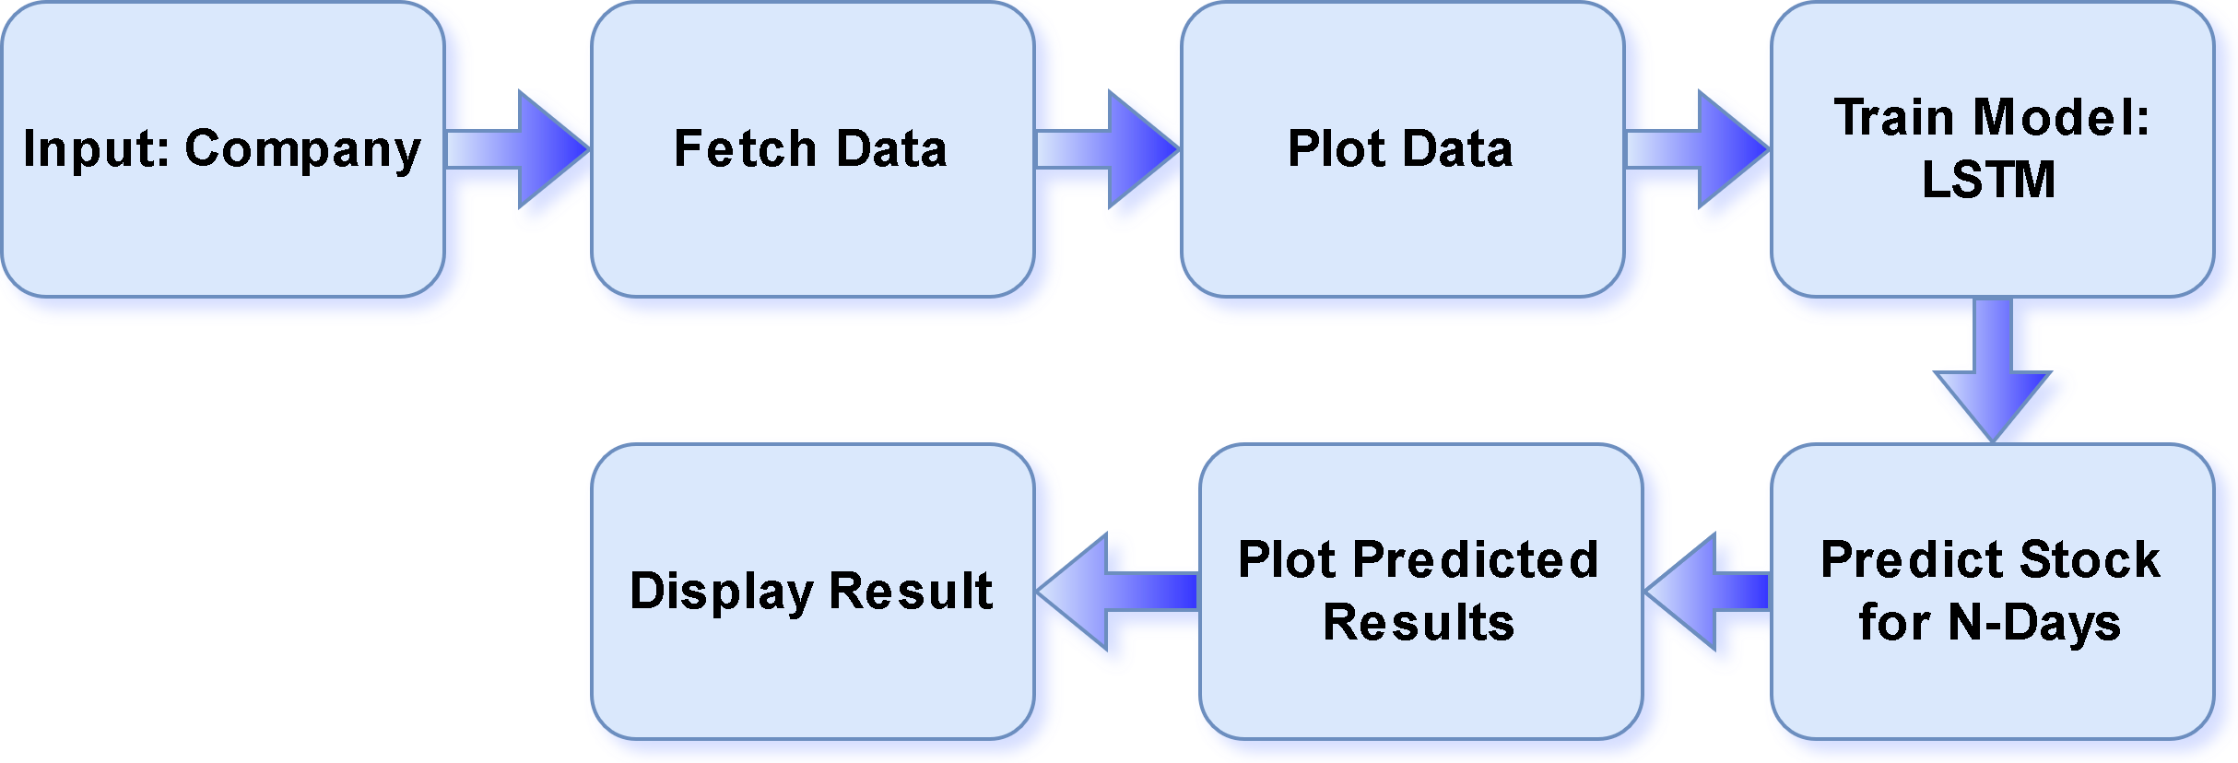
System Architecture
Stock Trend Predication

Slide 8
System Deployment Approach
Stock Trend Predication
Cloud/On-Premises: Choose AWS, Google Cloud (scalable) or on-premises (control)
Containers (Optional): Dockerize for portability, scalability.
Real-time/Batch: Efficient models & data pipelines for real-time; less stringent latency allows complex models for batch.
Secure API: User input, prediction, result return with authentication/authorization for external users.
Monitor & Secure: Track performance, secure access, encrypt data, update software.
Version Control & CI/CD: Track changes (Git), automate testing/deployment.
Scale & Optimize: Auto-scale for demand, monitor and optimize model performance.

Slide 9
Algorithm & Deployment
Stock Trend Predication
Algorithm
LSTM: LSTM stands for Long Short-Term Memory, a type of recurrent neural network (RNN) particularly useful for analyzing sequential data like stock prices. Unlike standard RNNs, LSTMs can handle long-term dependencies in data thanks to their special architecture with a cell state and a gating mechanism. This allows them to learn and remember important information from the past, which is crucial for capturing trends in stock prices.
Deployment
Real-time vs. Batch (Efficiency, latency)
Infrastructure (Cloud, containers)
API Integration (Documented, secure)

Slide 10
Conclusion
Stock Trend Predication
In conclusion, the development and implementation of this basic level project on stock trend prediction for stock buying decisions using AIML represent a significant step towards understanding the application of Artificial Intelligence and Machine Learning in financial decision-making. Through this project, we have gained valuable insights into the process of analyzing historical stock data and utilizing AIML algorithms to provide actionable recommendations for investors. Our project focused on predicting whether to buy or not based on stock trend predictions, employing simple AIML techniques and LSTM Model. By leveraging AIML to analyze historical stock data and identify patterns indicative of future price movements, investors can mitigate risks and capitalize on opportunities in the dynamic stock market environment.

Slide 11
Future Scope
Stock Trend Predication
This basic level project represents just a small step in our journey, it underscores the transformative potential of AIML in revolutionizing financial decision-making. By continuing to learn, experiment, and innovate, we can unlock new possibilities and empower individuals to navigate the complexities of the stock market with greater confidence and efficiency.

Slide 12
Stock Trend Predication
Reference
https://youtu.be/s3CnE2tqQdo?si=AZ9RFevIqYaNFJs-
https://github.com/034adarsh/Stock-Price-Prediction-Using-LSTM
https://streamlit.io/components
Notes:
Reference
These are the references for this session.
12

Slide 13
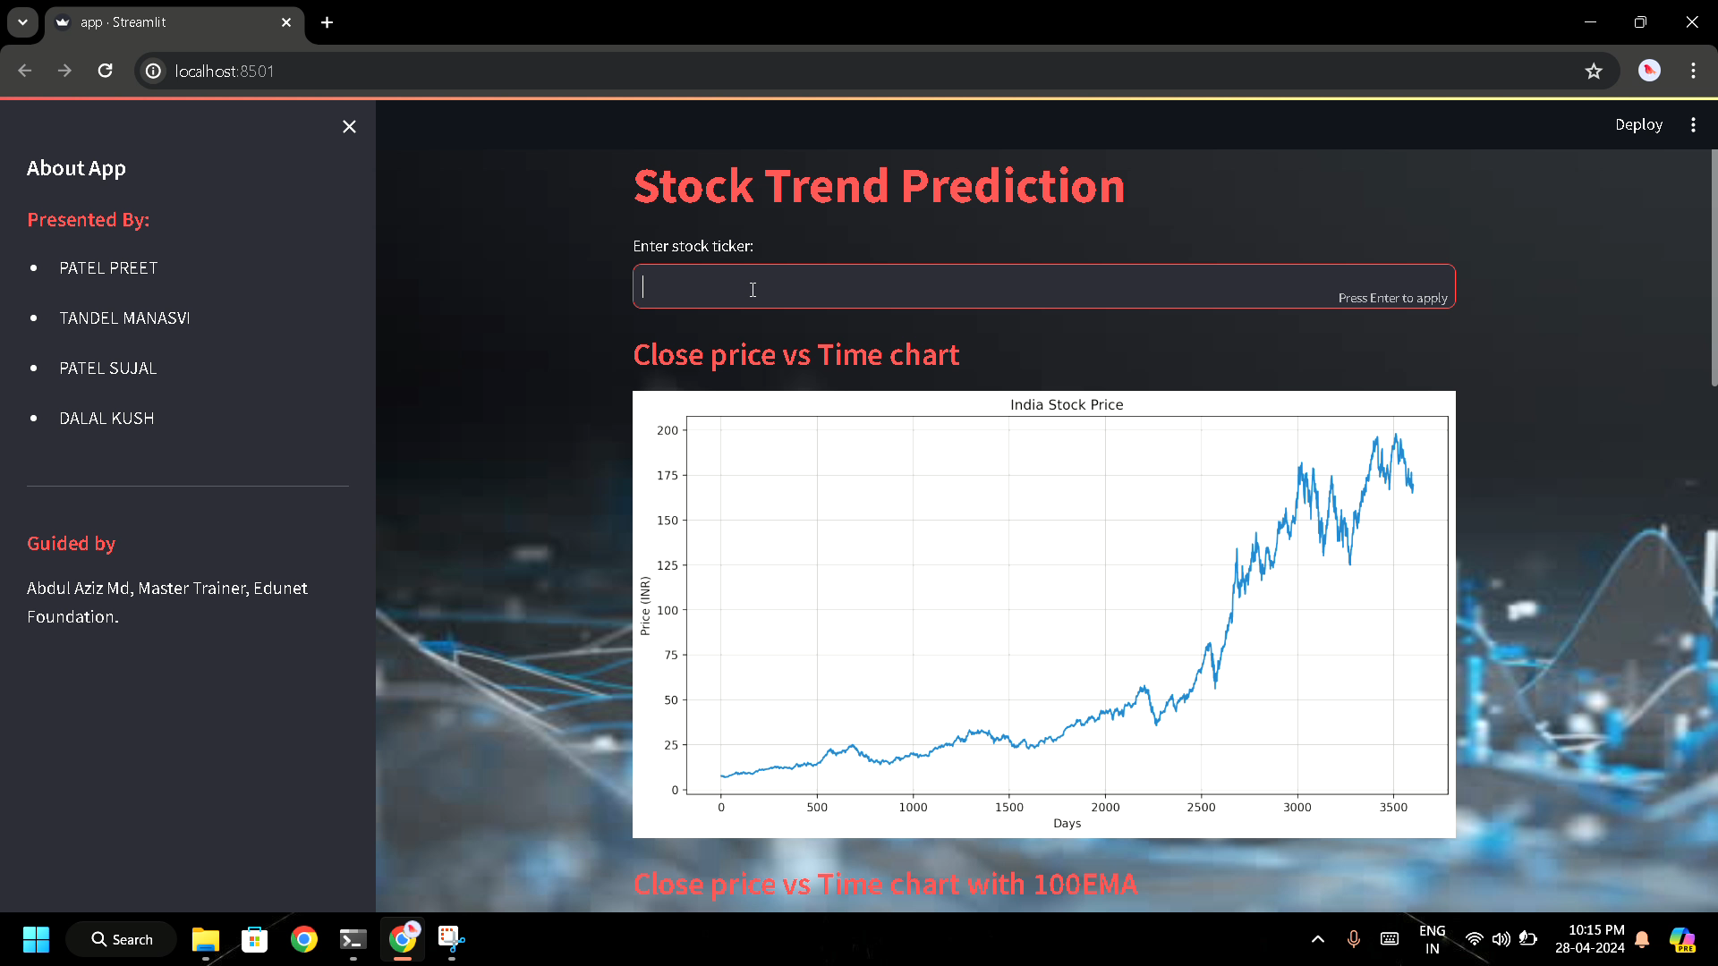
Stock Trend Predication

Slide 14
Stock Trend Predication
Thank you!
Notes:
thank you very much for joining this PPT, keep learning.
14

